Slide 1
Anthrax
Assist. Prof. Dr. Hussein ALNaji

Slide 2
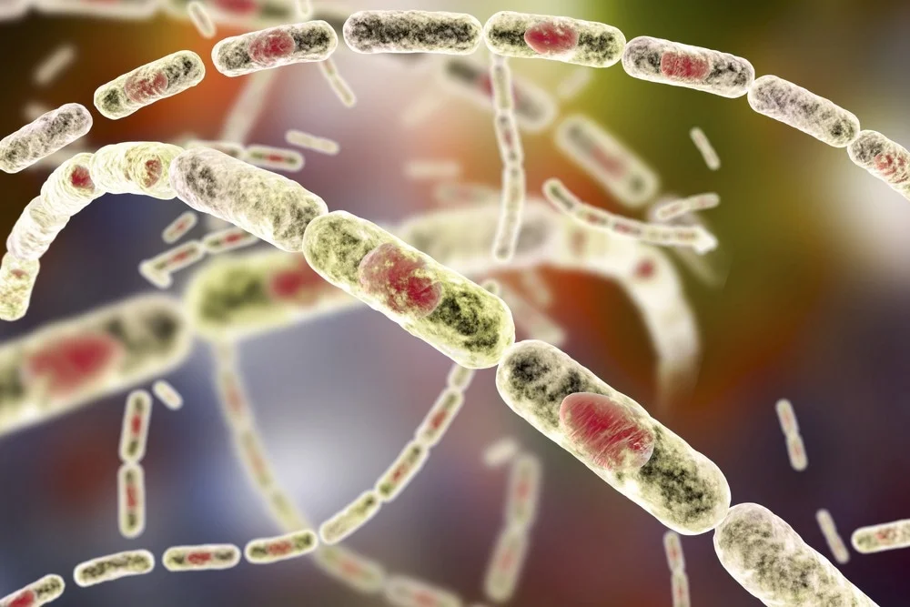
Anthrax is a serious infectious disease caused by gram-positive, rod-shaped bacteria known as Bacillus anthracis. It occurs naturally in soil and commonly affects domestic and wild animals around the world. People can get sick with anthrax if they come in contact with infected animals or contaminated animal products. Anthrax can cause severe illness in both humans and animals. Anthrax is not contagious, which means you can’t catch it from another person like the cold or flu.

Slide 3
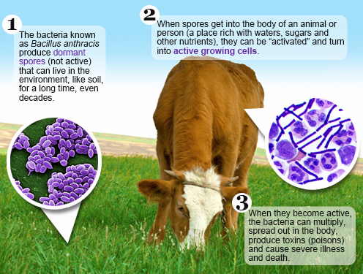
Transmission and spread
1- Anthrax typically does not spread from animal to animal nor from person to person.
2- Domestic become infected when they breathe in or ingest spores in contaminated soil, plants, or water. These animals can include cattle, sheep, goats, antelope, and deer.
3- Carnivores and humans can become infected by eating meat from an infected animal. Typically, however, animals become infected by ingesting spores that are in the soil or in feed.

Slide 4
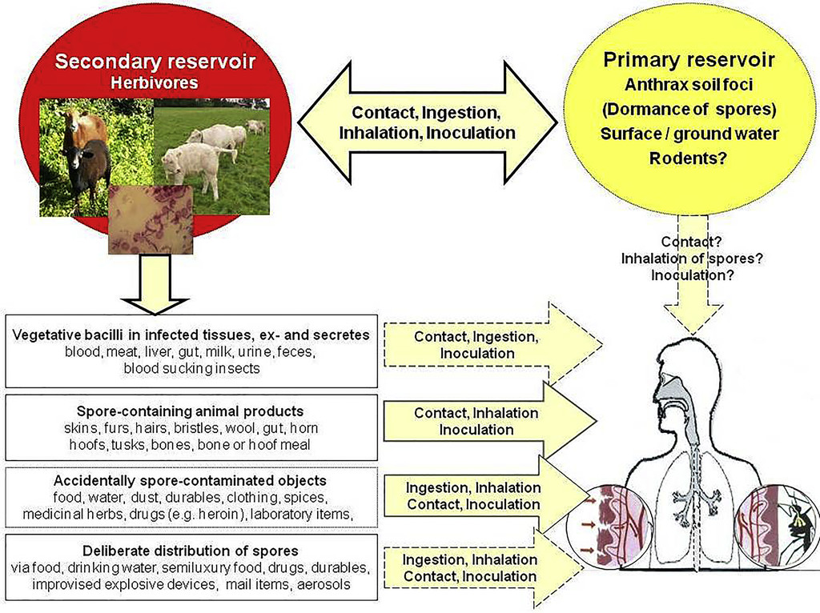

Slide 5
Symptoms of Anthrax
here are four common routes of anthrax infection, each with different signs and symptoms. In most cases, symptoms develop within six days of exposure to the bacteria.
A- Cutaneous anthrax
A skin-related (cutaneous) anthrax infection enters your body through your skin, usually through a cut or other sore. It's by far the most common route of the disease. The signs include
1- A raised, itchy bump resembling an insect bite that quickly develops into a painless sore with a black center
2-Swelling in the sore and nearby lymph glands
3- Sometimes, flu-like symptoms including fever and headache

Slide 6
B- Gastrointestinal anthrax
A gastrointestinal anthrax infection results from eating undercooked meat from an infected animal. It can affect your gastrointestinal tract from your throat to your colon. Signs and symptoms include:
Nausea, Vomiting, Abdominal pain, Headache, Loss of appetite, Fever, Severe, bloody diarrhea in the later stages of the disease, Sore throat and difficulty swallowing, Swollen neck
C- Injection anthrax
This recently identified route of anthrax infection has so far been reported only in Europe. It's contracted through injecting illegal drugs. Initial signs and symptoms include:
Redness at the area of injection (without an area that changes to black)

Slide 7
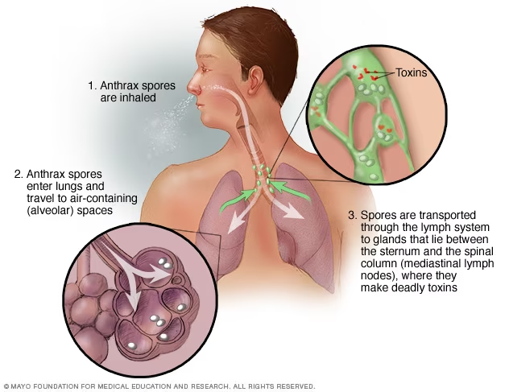
D- Inhalation anthrax
Inhalation anthrax develops when you breathe in anthrax spores. It's the most deadly form of the disease, and is often fatal, even with treatment. Initial signs and symptoms include:
Flu-like symptoms for a few hours or days, such as sore throat, mild fever, fatigue and muscle aches

Slide 8
Prevention
To prevent infection after being exposed to anthrax spores, the Centers for Disease Control and Prevention recommends:
1- A 60-day treatment with antibiotics — ciprofloxacin, doxycycline and levofloxacin are approved for adults and children
2- A three-dose series of anthrax vaccine
3- In some cases, treatment with monoclonal antibodies — raxibacumab and obiltoxaximab.
4- Anthrax vaccine
5- Avoiding infected animals

Slide 9
Thank you

